Slide 1
What is Knowledge Representation?
Knowledge Representation in AI describes the representation of knowledge.
Basically, it is a study of how the beliefs, intentions, and judgments of an intelligent agent can be expressed suitably for automated reasoning.
One of the primary purposes of Knowledge Representation includes modelling intelligent behaviour for an agent.

Slide 2
The different kinds of knowledge that need to be represented in AI include:
Objects
Events
Performance
Facts
Meta-Knowledge
methods of planning, modeling, tagging, learning and every modification of a domain knowledge.
Knowledge-base
capability of maintaining an internal state of knowledge, reason over that knowledge, update their knowledge after observations and take actions. These agents can represent the world with some formal representation and act intelligently.

Slide 3
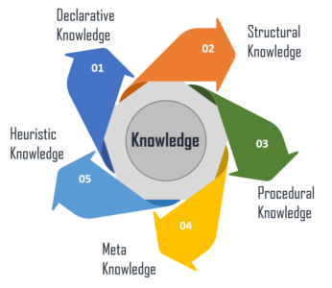
Different Types of Knowledge

Slide 4
Declarative Knowledge – It includes concepts, facts, and objects and expressed in a declarative sentence.
Structural Knowledge – It is a basic problem-solving knowledge that describes the relationship between concepts and objects.
Procedural Knowledge – This is responsible for knowing how to do something and includes rules, strategies, procedures, etc.
Meta Knowledge – Meta Knowledge defines knowledge about other types of Knowledge.
Heuristic Knowledge – This represents some expert knowledge in the field or subject.

Slide 5
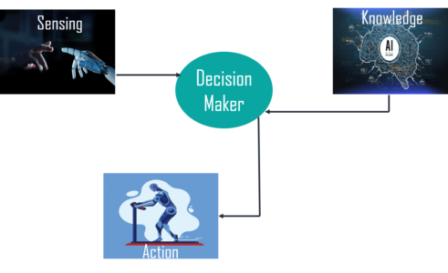
What is the Relation between Knowledge & Intelligence?

Slide 6
Cycle of Knowledge Representation in AI
Artificial Intelligent Systems usually consist of various components to display their intelligent behavior. Some of these components include:
Perception Learning Knowledge Representation & Reasoning Planning Execution

Slide 7
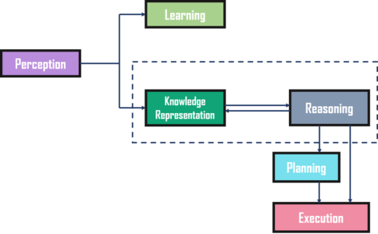

Slide 8
The Perception component retrieves data or information from the environment. with the help of this component, you can retrieve data from the environment, find out the source of noises and check if the AI was damaged by anything. Also, it defines how to respond when any sense has been detected.
Then, there is the Learning Component that learns from the captured data by the perception component. The goal is to build computers that can be taught instead of programming them. Learning focuses on the process of self-improvement. In order to learn new things, the system requires knowledge acquisition, inference, acquisition of heuristics, faster searches, etc.
The main component in the cycle is Knowledge Representation and Reasoning which shows the human-like intelligence in the machines. Knowledge representation is all about understanding intelligence. Instead of trying to understand or build brains from the bottom up, its goal is to understand and build intelligent behavior from the top-down and focus on what an agent needs to know in order to behave intelligently. Also, it defines how automated reasoning procedures can make this knowledge available as needed.
The Planning and Execution components depend on the analysis of knowledge representation and reasoning. Here, planning includes giving an initial state, finding their preconditions and effects, and a sequence of actions to achieve a state in which a particular goal holds. Now once the planning is completed, the final stage is the execution of the entire process.

Slide 9
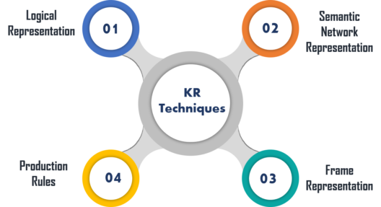
Techniques of Knowledge Representation in AI

Slide 10
Logical Representation
Logical representation is a language with some definite rules which deal with propositions and has no ambiguity in representation. It represents a conclusion based on various conditions and lays down some important communication rules. Also, it consists of precisely defined syntax and semantics which supports the sound inference. Each sentence can be translated into logics using syntax and semantics.
Advantages:
Logical representation helps to perform logical reasoning.
This representation is the basis for the programming languages.
Disadvantages:
Logical representations have some restrictions and are challenging to work with.
This technique may not be very natural, and inference may not be very efficient.

Slide 11
Semantic Network Representation
Semantic networks work as an alternative of predicate logic for knowledge representation. In Semantic networks, you can represent your knowledge in the form of graphical networks. This network consists of nodes representing objects and arcs which describe the relationship between those objects. Also, it categorizes the object in different forms and links those objects.
This representation consist of two types of relations:
IS-A relation (Inheritance)
Kind-of-relation

Slide 12
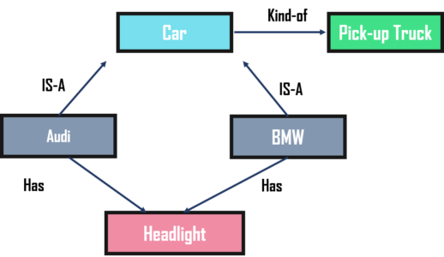

Slide 13
Advantages:
Semantic networks are a natural representation of knowledge.
Also, it conveys meaning in a transparent manner.
These networks are simple and easy to understand.
Disadvantages:
Semantic networks take more computational time at runtime.
Also, these are inadequate as they do not have any equivalent quantifiers.
These networks are not intelligent and depend on the creator of the system.

Slide 14
Frame Representation
A frame is a record like structure that consists of a collection of attributes and values to describe an entity in the world. These are the AI data structure that divides knowledge into substructures by representing stereotypes situations. Basically, it consists of a collection of slots and slot values of any type and size. Slots have names and values which are called facets.
Advantages:
It makes the programming easier by grouping the related data.
Frame representation is easy to understand and visualize.
It is very easy to add slots for new attributes and relations.
Also, it is easy to include default data and search for missing values.
Disadvantages:
In frame system inference, the mechanism cannot be easily processed.
The inference mechanism cannot be smoothly proceeded by frame representation.
It has a very generalized approach.

Slide 15
Production Rules
In production rules, agent checks for the condition and if the condition exists then production rule fires and corresponding action is carried out. The condition part of the rule determines which rule may be applied to a problem. Whereas, the action part carries out the associated problem-solving steps. This complete process is called a recognize-act cycle.
The production rules system consists of three main parts:
The set of production rules
Working Memory
The recognize-act-cycle

Slide 16
Advantages:
The production rules are expressed in natural language.
The production rules are highly modular and can be easily removed or modified.
Disadvantages:
It does not exhibit any learning capabilities and does not store the result of the problem for future uses.
During the execution of the program, many rules may be active. Thus, rule-based production systems are inefficient.

Slide 17
Representation Requirements
A good knowledge representation system must have properties such as:
Representational Accuracy: It should represent all kinds of required knowledge.
Inferential Adequacy: It should be able to manipulate the representational structures to produce new knowledge corresponding to the existing structure.
Inferential Efficiency: The ability to direct the inferential knowledge mechanism into the most productive directions by storing appropriate guides.
Acquisitional efficiency: The ability to acquire new knowledge easily using automatic methods.

Slide 18
Approaches to knowledge representation:
Simple Relational Knowledge
Inheritable Knowledge
Inferential Knowledge
Procedural knowledge

